Slide 1
Data Structures

Slide 2
Data Structure
A data structure is a storage that is used to store and organize data. It is a way of arranging data on a computer so that it can be accessed and updated efficiently. A data structure is not only used for organizing the data. It is also used for processing, retrieving, and storing data.
A data structure is not only used for organizing the data. It is also used for processing, retrieving, and storing data. There are different basic and advanced types of data structures that are used in almost every program or software system that has been developed. So we must have good knowledge about data structures.

Slide 3
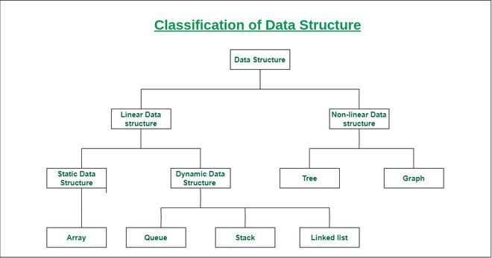
Linear data structure: Data structure in which data elements are arranged sequentially or linearly, where each element is attached to its previous and next adjacent elements, is called a linear data structure. Examples of linear data structures are array, stack, queue, linked list, etc.
Static data structure: Static data structure has a fixed memory size. It is easier to access the elements in a static data structure. An example of this data structure is an array.
Dynamic data structure: In dynamic data structure, the size is not fixed. It can be randomly updated during the runtime which may be considered efficient concerning the memory (space) complexity of the code. Examples of this data structure are queue, stack, etc.
Non-linear data structure: Data structures where data elements are not placed sequentially or linearly are called non-linear data structures. In a non-linear data structure, we can’t traverse all the elements in a single run only. Examples of non-linear data structures are trees and graphs.

Slide 4
Abstract Data Type
Abstract Data type (ADT) is a type (or class) for objects whose behavior is defined by a set of values and a set of operations. The definition of ADT only mentions what operations are to be performed but not how these operations will be implemented. It does not specify how data will be organized in memory and what algorithms will be used for implementing the operations. It is called “abstract” because it gives an implementation-independent view.
The user of data type does not need to know how that data type is implemented, for example, we have been using Primitive values like int, float, char data types only with the knowledge that these data type can operate and be performed on without any idea of how they are implemented.

Slide 5
Types of ADT
Stack ADT In Stack ADT Implementation instead of data being stored in each node, the pointer to data is stored.
The program allocates memory for the data and address is passed to the stack ADT.
The head node and the data nodes are encapsulated in the ADT. The calling function can only see the pointer to the stack.
The stack head structure also contains a pointer to top and count of number of entries currently in stack.
push() – Insert an element at one end of the stack called top.
pop() – Remove and return the element at the top of the stack, if it is not empty.
peek() – Return the element at the top of the stack without removing it, if the stack is not empty.
size() – Return the number of elements in the stack.
isEmpty() – Return true if the stack is empty, otherwise return false.
isFull() – Return true if the stack is full, otherwise return false.
Queue ADT
The queue abstract data type (ADT) follows the basic design of the stack abstract data type.
Each node contains a void pointer to the data and the link pointer to the next element in the queue. The program’s responsibility is to allocate memory for storing the data.
enqueue() – Insert an element at the end of the queue.
dequeue() – Remove and return the first element of the queue, if the queue is not empty.
peek() – Return the element of the queue without removing it, if the queue is not empty.
size() – Return the number of elements in the queue.
isEmpty() – Return true if the queue is empty, otherwise return false.
isFull() – Return true if the queue is full, otherwise return false.

Slide 6
Asymptotic Notation
Data structure is a way of organizing the data efficiently and that efficiency is measured either in terms of time or space.
Asymptotic notations are mathematical tools to represent the time complexity of algorithms for asymptotic analysis.
The main question arises in our mind that on what basis should we compare the time complexity of data structures?
Usually, the time required by an algorithm comes under three types:
Worst case: It defines the input for which the algorithm takes a huge time.
Average case: It takes average time for the program execution.
Best case: It defines the input for which the algorithm takes the lowest time

Slide 7
Types of Asymptotic Notation
The commonly used asymptotic notations used for calculating the running time complexity of an algorithm is given below:
Big oh Notation (?)
Omega Notation (Ω)
Theta Notation (θ)

Slide 8
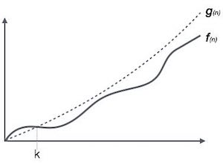
Big Oh Notation, Ο
The notation Ο(n) is the formal way to express the upper bound of an algorithm's running time. It measures the worst case time complexity or the longest amount of time an algorithm can possibly take to complete.
This notation provides an upper bound on a function which ensures that the function never grows faster than the upper bound. So, it gives the least upper bound on a function so that the function never grows faster than this upper bound.

Slide 9
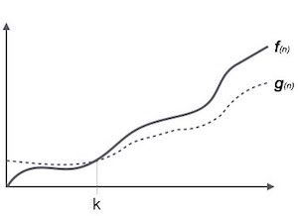
Omega Notation, Ω
The notation Ω(n) is the formal way to express the lower bound of an algorithm's running time. It measures the best case time complexity or the best amount of time an algorithm can possibly take to complete.
Ω Notation can be useful when we have a lower bound on the time complexity of an algorithm. As discussed in the previous post, the best case performance of an algorithm is generally not useful, the Omega notation is the least used notation among all three.

Slide 10
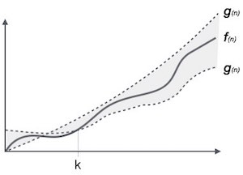
Theta Notation (θ)
The theta notation mainly describes the average case scenarios.
It represents the realistic time complexity of an algorithm. Every time, an algorithm does not perform worst or best, in real-world problems, algorithms mainly fluctuate between the worst-case and best-case, and this gives us the average case of the algorithm.
Big theta is mainly used when the value of worst-case and the best-case is same.
It is the formal way to express both the upper bound and lower bound of an algorithm running time.

Slide 11
Time-Space Trade-Off in Algorithms
A tradeoff is a situation where one thing increases and another thing decreases. It is a way to solve a problem in:
Either in less time and by using more space, or
In very little space by spending a long amount of time.
Types of Space-Time Trade-off
Compressed or Uncompressed data
Re Rendering or Stored images
Smaller code or loop unrolling
Lookup tables or Recalculation

Slide 12
Compressed or Uncompressed data: A space-time trade-off can be applied to the problem of data storage. If data stored is uncompressed, it takes more space but less time. But if the data is stored compressed, it takes less space but more time to run the decompression algorithm. There are many instances where it is possible to directly work with compressed data. In that case of compressed bitmap indices, where it is faster to work with compression than without compression.
Re-Rendering or Stored images: In this case, storing only the source and rendering it as an image would take more space but less time i.e., storing an image in the cache is faster than re-rendering but requires more space in memory.

Slide 13
Smaller code or Loop Unrolling: Smaller code occupies less space in memory but it requires high computation time that is required for jumping back to the beginning of the loop at the end of each iteration. Loop unrolling can optimize execution speed at the cost of increased binary size. It occupies more space in memory but requires less computation time.
Lookup tables or Recalculation: In a lookup table, an implementation can include the entire table which reduces computing time but increases the amount of memory needed. It can recalculate i.e., compute table entries as needed, increasing computing time but reducing memory requirements.

Slide 14

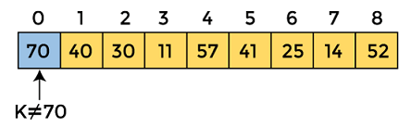
Linear Search
Linear search is also called as sequential search algorithm. It is the simplest searching algorithm. In Linear search, we simply traverse the list completely and match each element of the list with the item whose location is to be found. If the match is found, then the location of the item is returned; otherwise, the algorithm returns NULL.
Let the elements of array are -
Let the element to be searched is K = 41
The value of K, i.e., 41, is not matched with the first element of the array. So, move to the next element. And follow the same process until the respective element is found.

Slide 15
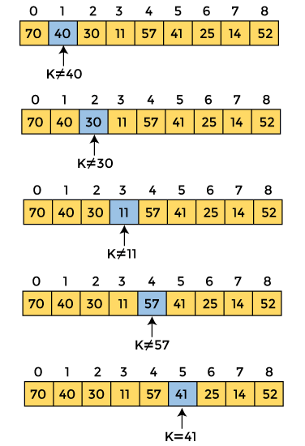

Slide 16
#include<stdio.h>
int main()
{
int a[20],i,x,n;
printf("How many elements?");
scanf("%d",&n);
printf("Enter array elements:n");
for(i=0;i<n;++i)
scanf("%d",&a[i]);
printf("nEnter element to search:");
scanf("%d",&x);
for(i=0;i<n;++i)
if(a[i]==x)
break;
if(i<n)
printf("Element found at index %d",i);
else
printf("Element not found");
return 0;
}

Slide 17
Time complexity
Best Case O(1)
Average Case O(n)
Worst Case O(n)
Best Case Complexity - In Linear search, best case occurs when the element we are finding is at the first position of the array. The best-case time complexity of linear search is O(1).
Average Case Complexity - The average case time complexity of linear search is O(n).
Worst Case Complexity - In Linear search, the worst case occurs when the element we are looking is present at the end of the array. The worst-case in linear search could be when the target element is not present in the given array, and we have to traverse the entire array. The worst-case time complexity of linear search is O(n).

Slide 18
Binary search
Binary Search is a searching algorithm used in a sorted array by repeatedly dividing the search interval in half. The idea of binary search is to use the information that the array is sorted and reduce the time complexity to O(Log n).
There are two methods to implement the binary search algorithm -
Iterative method
Recursive method
The recursive method of binary search follows the divide and conquer approach.

Slide 19
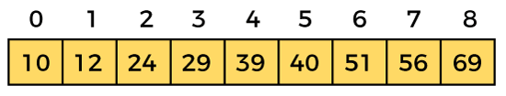
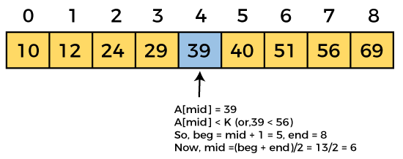
Recursive method
Let the element to search is, K = 56
mid = (beg + end)/2
So, in the given array -
beg = 0
end = 8
mid = (0 + 8)/2 = 4. So, 4 is the mid of the array.

Slide 20
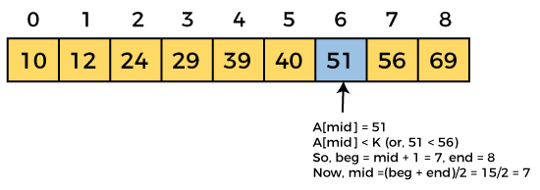
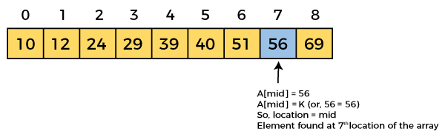
Now, the element to search is found. So algorithm will return the index of the element matched.

Slide 21
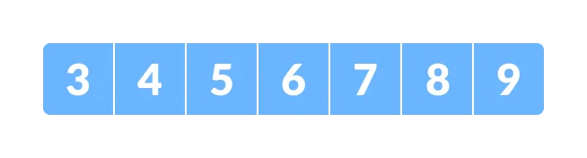
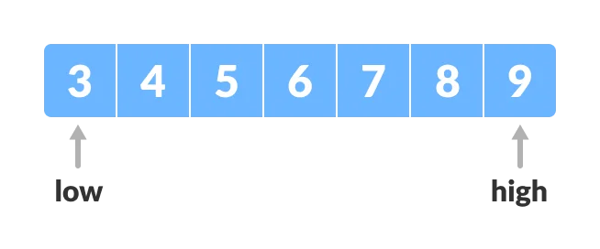
Iterative Method
Find the middle element mid of the array ie. arr[(low + high)/2] = 6.
The array in which searching is to be performed is:
Let x = 4 be the element to be searched.
Set two pointers low and high at the lowest and the highest positions respectively.
Find the middle element mid of the array ie. arr[(low + high)/2] = 6.

Slide 22
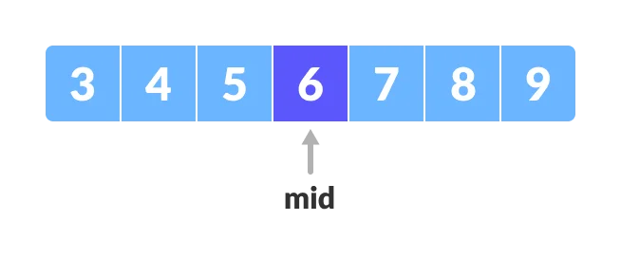
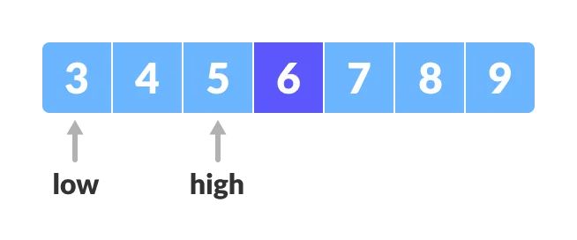
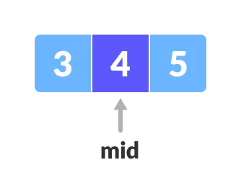
If x == mid, then return mid. Else, compare the element to be searched with m.
If x > mid, compare x with the middle element of the elements on the right side of mid. This is done by setting low to low = mid + 1.
Else, compare x with the middle element of the elements on the left side of mid. This is done by setting high to high = mid - 1.
Repeat steps 3 to 6 until low meets high.
x = 4 is found.

Slide 23
Iteration method
do until the pointers low and high meet each other.
mid = (low + high)/2
if (x == arr[mid])
return mid
else if (x > arr[mid]) // x is on the right side
low = mid + 1
else // x is on the left side
high = mid - 1
Recursive Method
binarySearch(arr, x, low, high)
if low > high
return False
else
mid = (low + high) / 2
if x == arr[mid]
return mid
else if x > arr[mid] // x is on the right side
return binarySearch(arr, x, mid + 1, high)
else // x is on the right side
return binarySearch(arr, x, low, mid - 1)

Slide 24
Binary Search complexity
Time Complexity
Best Case | O(1)
Average Case | O(logn)
Worst Case | O(logn)
Best Case Complexity - In Binary search, best case occurs when the element to search is found in first comparison, i.e., when the first middle element itself is the element to be searched. The best-case time complexity of Binary search is O(1).
Average Case Complexity - The average case time complexity of Binary search is O(logn).
Worst Case Complexity - In Binary search, the worst case occurs, when we have to keep reducing the search space till it has only one element. The worst-case time complexity of Binary search is O(logn).

Slide 25
Stack ADT
The following are some common operations implemented on the stack:
push(): When we insert an element in a stack then the operation is known as a push. If the stack is full then the overflow condition occurs.
pop(): When we delete an element from the stack, the operation is known as a pop. If the stack is empty means that no element exists in the stack, this state is known as an underflow state.
isEmpty(): It determines whether the stack is empty or not.
isFull(): It determines whether the stack is full or not.'
peek(): It returns the element at the given position.
count(): It returns the total number of elements available in a stack.
change(): It changes the element at the given position.
display(): It prints all the elements available in the stack.

Slide 26
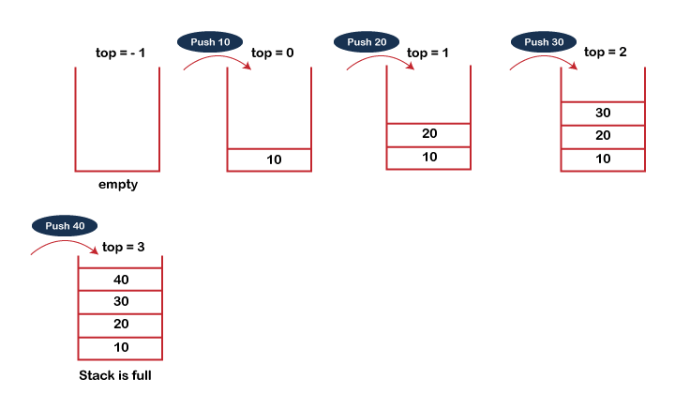
PUSH operation
The steps involved in the PUSH operation is given below:
Before inserting an element in a stack, we check whether the stack is full.
If we try to insert the element in a stack, and the stack is full, then the overflow condition occurs.
When we initialize a stack, we set the value of top as -1 to check that the stack is empty.
When the new element is pushed in a stack, first, the value of the top gets incremented, i.e., top=top+1, and the element will be placed at the new position of the top.
The elements will be inserted until we reach the max size of the stack.

Slide 27
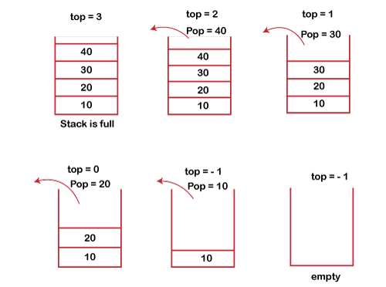
POP operation
The steps involved in the POP operation is given below:
1.Before deleting the element from the stack, we check whether the stack is empty.
2.If we try to delete the element from the empty stack, then the underflow conditio occurs.
3.If the stack is not empty, we first access the element which is pointed by the top
4.Once the pop operation is performed, the top is decremented by 1, i.e., top=top-1.
DS Stack Introduction

Slide 28
Balancing of symbols: Stack is used for balancing a symbol.
String reversal: Stack is also used for reversing a string. For example, we want to reverse a "javaTpoint" string, so we can achieve this with the help of a stack.
First, we push all the characters of the string in a stack until we reach the null character.
After pushing all the characters, we start taking out the character one by one until we reach the bottom of the stack.
UNDO/REDO: It can also be used for performing UNDO/REDO operations. For example, we have an editor in which we write 'a', then 'b', and then 'c'; therefore, the text written in an editor is abc. So, there are three states, a, ab, and abc, which are stored in a stack. There would be two stacks in which one stack shows UNDO state, and the other shows REDO state.
If we want to perform UNDO operation, and want to achieve 'ab' state, then we implement pop operation.
Recursion: The recursion means that the function is calling itself again. To maintain the previous states, the compiler creates a system stack in which all the previous records of the function are maintained.
DFS(Depth First Search): This search is implemented on a Graph, and Graph uses the stack data structure

Slide 29
Backtracking: Suppose we have to create a path to solve a maze problem. If we are moving in a particular path, and we realize that we come on the wrong way. In order to come at the beginning of the path to create a new path, we have to use the stack data structure.
Expression conversion: Stack can also be used for expression conversion. This is one of the most important applications of stack. The list of the expression conversion is given below:
Infix to prefix
Infix to postfix
Prefix to infix
Prefix to postfix
Postfix to infix
Memory management: The stack manages the memory. The memory is assigned in the contiguous memory blocks. The memory is known as stack memory as all the variables are assigned in a function call stack memory. The memory size assigned to the program is known to the compiler. When the function is created, all its variables are assigned in the stack memory. When the function completed its execution, all the variables assigned in the stack are released.

Slide 30
The way to write arithmetic expression is known as a notation. An arithmetic expression can be written in three different but equivalent notations, i.e., without changing the essence or output of an expression. These notations are –
Infix
Prefix
Postfix
Infix notations are normal notations, that are used by us while write different mathematical expressions. The Prefix and Postfix notations are quite different
The above problem can be resolved by following the operator precedence rules. In the algebraic expression, the order of the operator precedence is given in the below table:
Operators | Symbols
Parenthesis | ( ), {}, [ ]
Exponents | ^
Multiplication and Division | *, /
Addition and Subtraction | + , -

Slide 31
Infix notation
When the operator is written in between the operands, then it is known as infix notation. Operand does not have to be always a constant or a variable; it can also be an expression itself.
For example,
(p + q) * (r + s)
Postfix Notation
The postfix expression is an expression in which the operator is written after the operands. For example, the postfix expression of infix notation ( 2+3) can be written as 23+. This notation style is known as Reversed Polish Notation
Prefix Notation
In this notation, operator is prefixed to operands, i.e. operator is written ahead of operands. For example, +ab. This is equivalent to its infix notation a + b. Prefix notation is also known as Polish Notation.

Slide 32
Algorithm
1.First Start scanning the expression from left to right
2.If the scanned character is an operand, output it, i.e. print it
Else
If the precedence of the scanned operator is higher than the precedence of the operator in the stack(or stack is empty or has'(‘), then push operator in the stack
Else, Pop all the operators, that have greater or equal precedence than the scanned operator. Once you pop them push this scanned operator. (If we see a parenthesis while popping then stop and push scanned operator in the stack)
3.If the scanned character is an ‘(‘, push it to the stack.
4.If the scanned character is an ‘)’, pop the stack and output it until a ‘(‘ is encountered, and discard both the parenthesis.
5.Now, we should repeat the steps 2 – 6 until the whole infix i.e. whole characters are scanned.
6.Print output
7.Do the pop and output (print) until stack is not empty

Slide 33
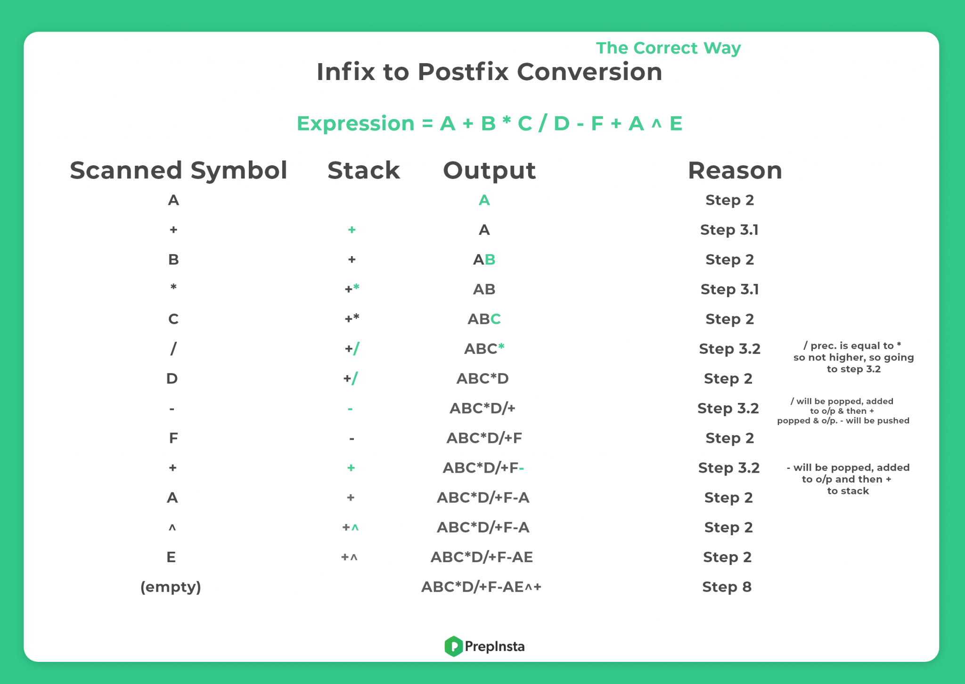

Slide 34
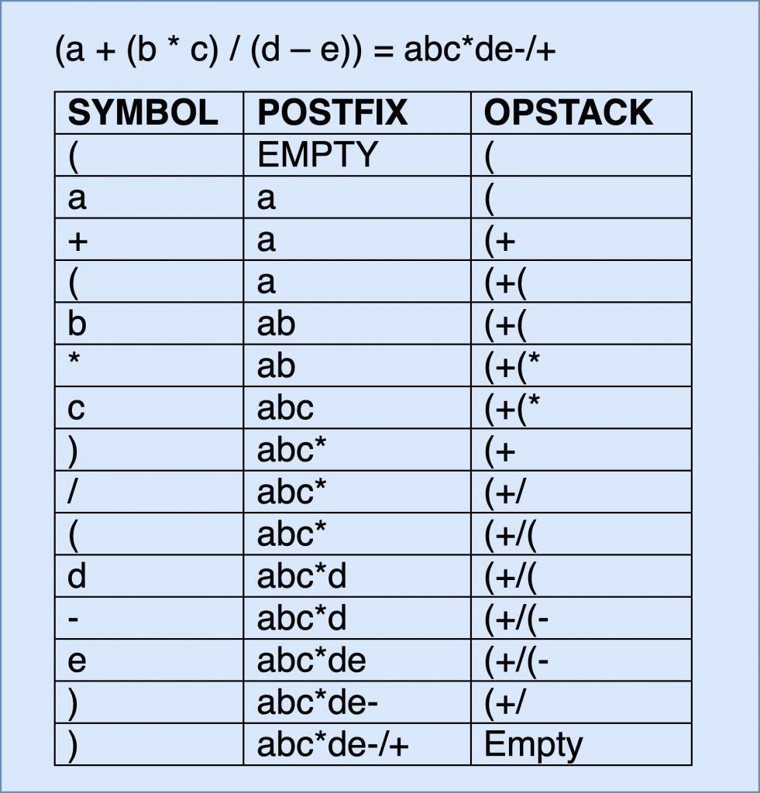

Slide 35
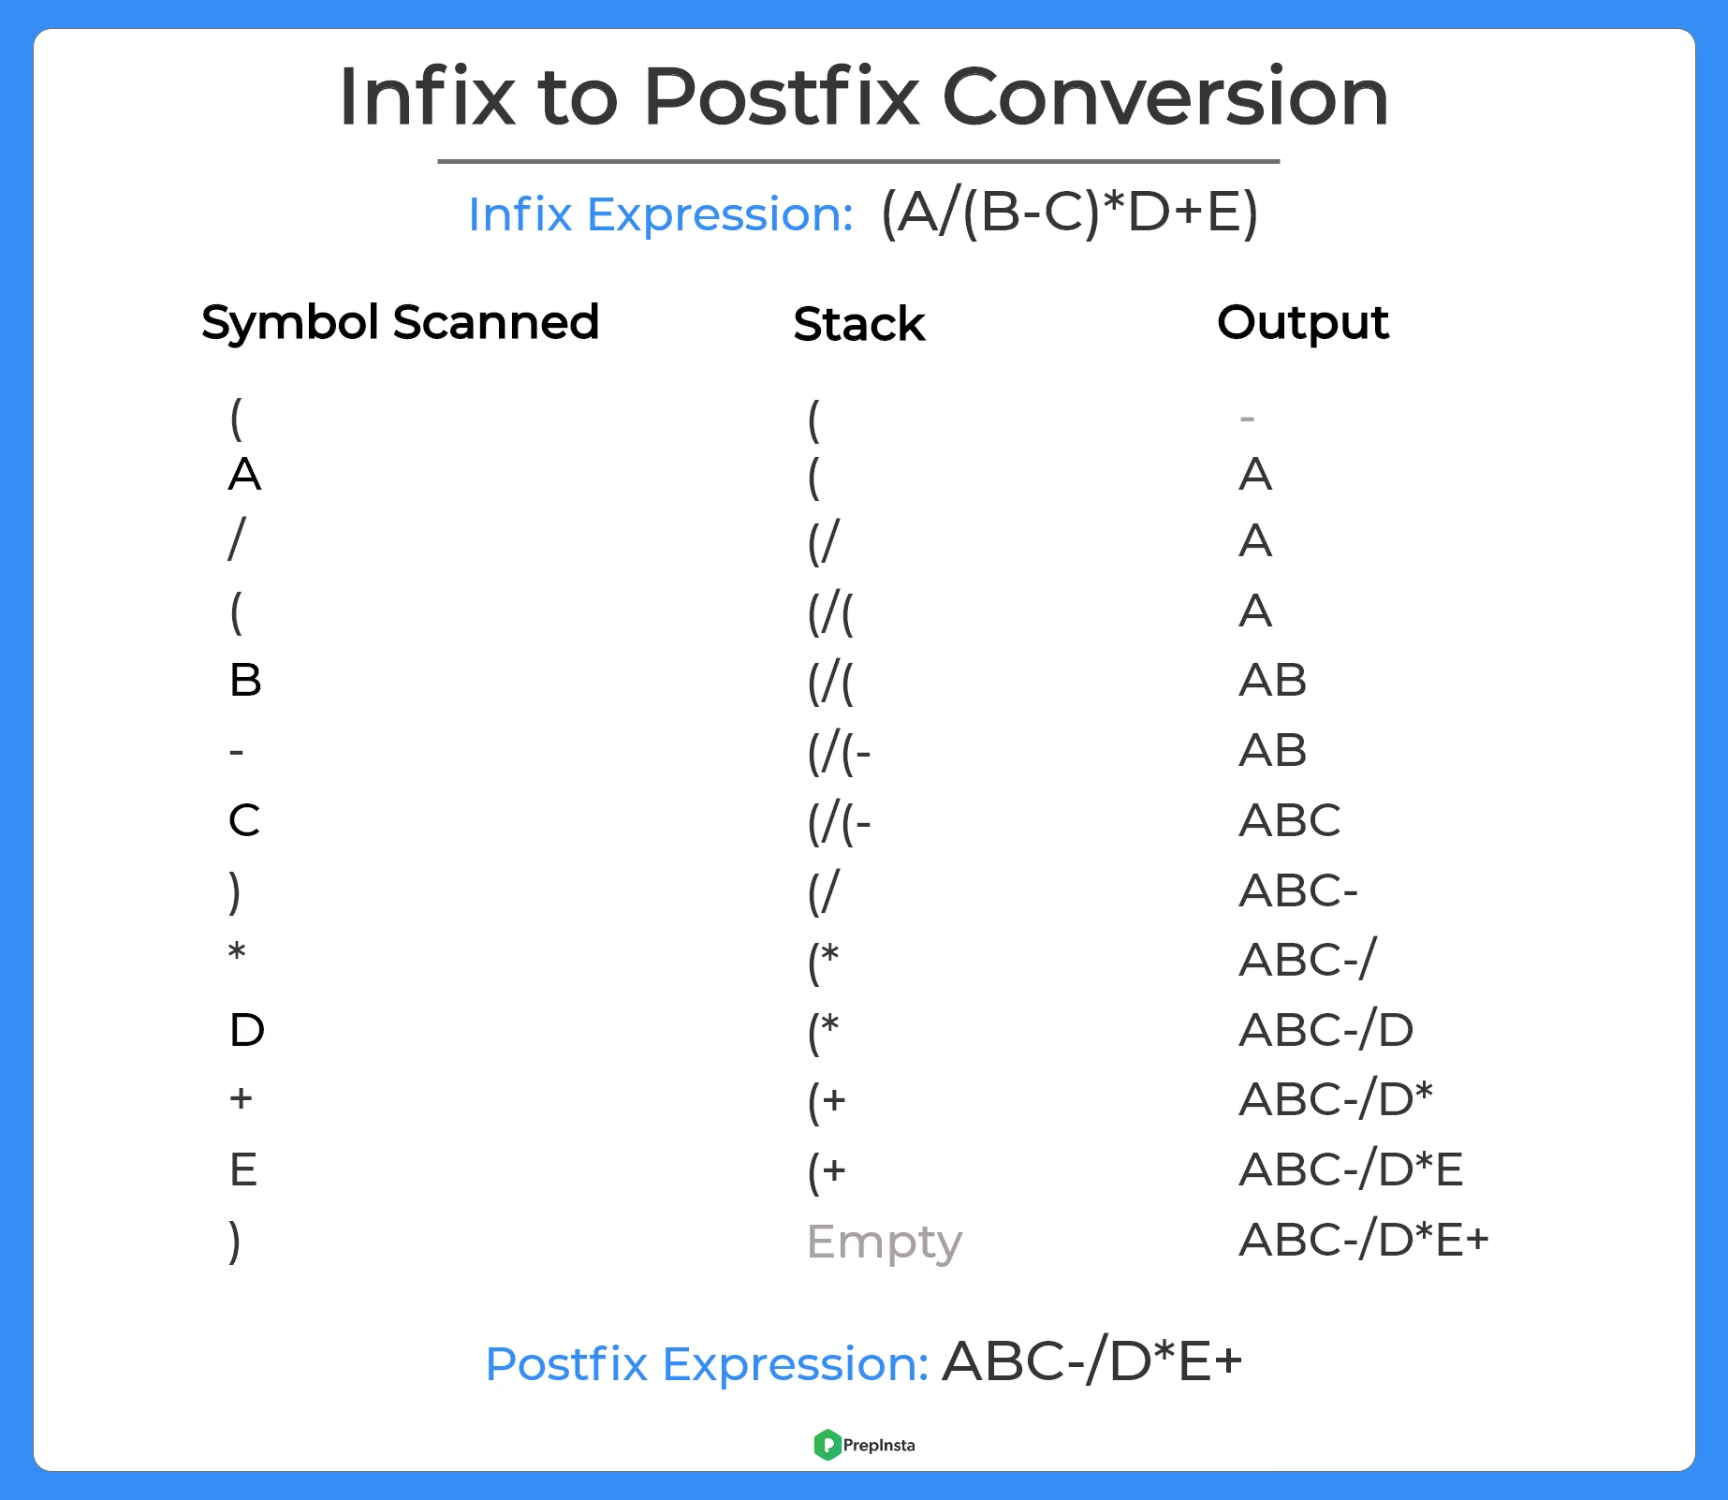

Slide 36
Evaluation of Prefix Expressions
Step 1: Put a pointer P at the end of the end
Step 2: If character at P is an operand push it to Stack
Step 3: If the character at P is an operator pop two elements from the Stack.
Operate on these elements according to the operator, and push the result back to the Stack
Step 4: Decrement P by 1 and go to Step 2 as long as there are characters left to be scanned in the expression.
Step 5: The Result is stored at the top of the Stack, return it
Step 6: End

